Slide 1

Created by students:
Mohamad Yaser Bazallah
Supervised by : Eng Rawan Kordi

Slide 2
GraphQL vs RESTful API: A Comprehensive Comparison
Introduction
Brief overview of APIs and their significance in modern web development.
Introduction to GraphQL and RESTful APIs.

Slide 3
What is RESTFul API?
Definition: Representational State Transfer.
Stateless communication through HTTP.
Resources, URIs, HTTP methods (GET, POST, PUT, DELETE).
Traditional approach for building web services.

Slide 4
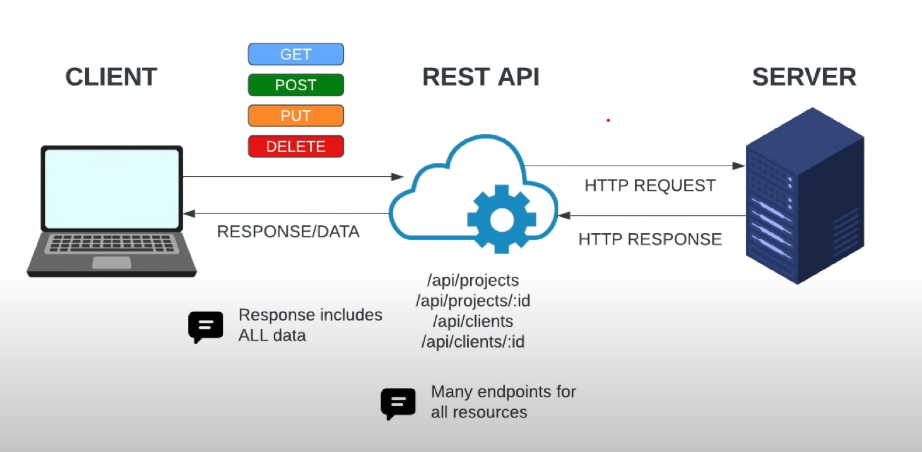

Slide 5
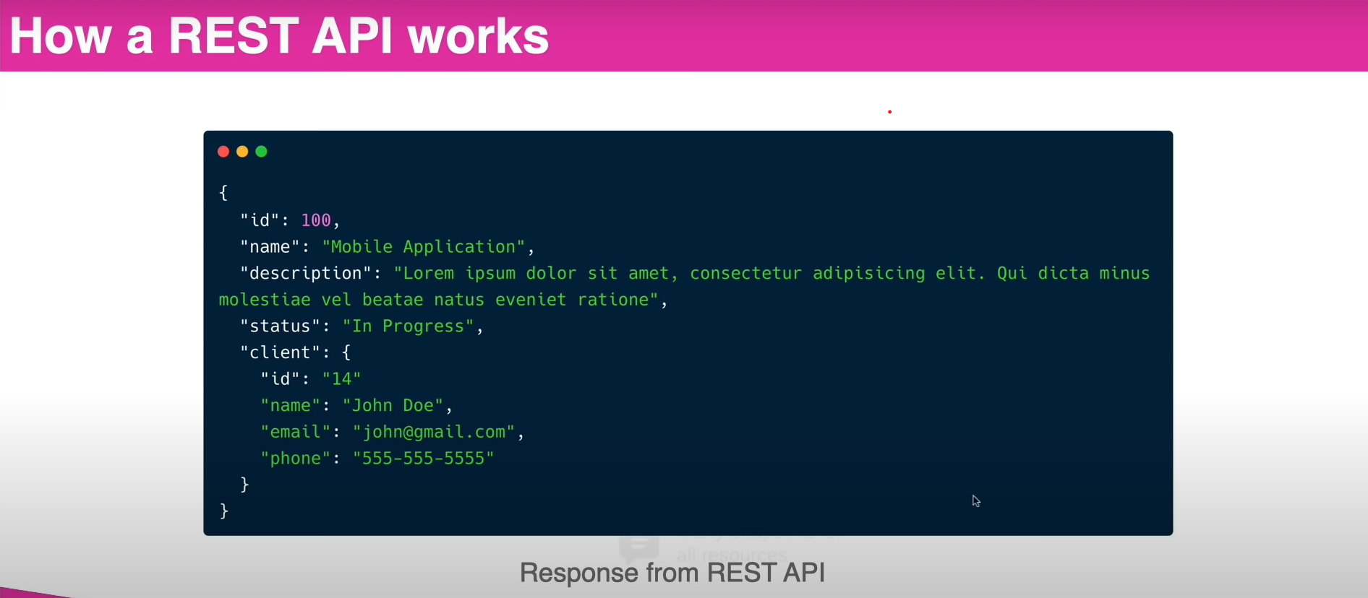

Slide 6
Strengths of RESTful API
Simplicity: Easy to understand and implement.
Scalability: Stateless nature allows for scalability.
Stateless Communication: Each request from a client contains all the information needed.
Weaknesses of RESTful API
Over-fetching: Retrieving more data than needed.
Under-fetching: Not getting enough data in a single request.
Versioning: Handling changes in data structures requires versioning.

Slide 7
What is GraphQL?
Definition: Query language for APIs.
Developed by Facebook in 2012.
Allows clients to request only the data they need.
GraphQL: Query Language
Declarative Data Fetching: Clients specify the shape and structure of the response.
Single Endpoint: All data is fetched from a single endpoint.
Strong Typing: Schema defines the structure of the data.

Slide 8
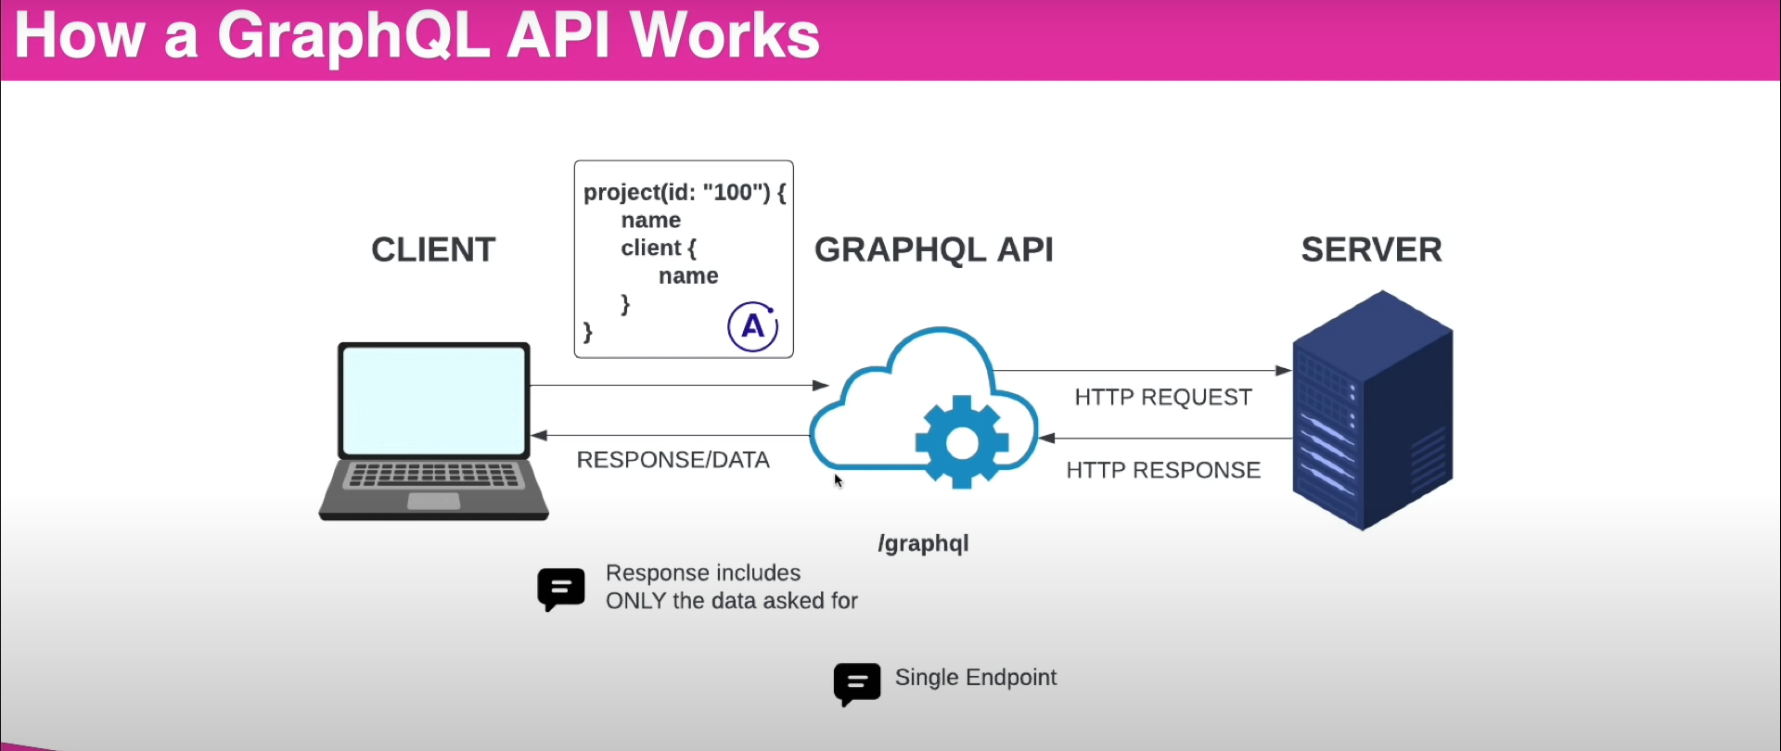

Slide 9
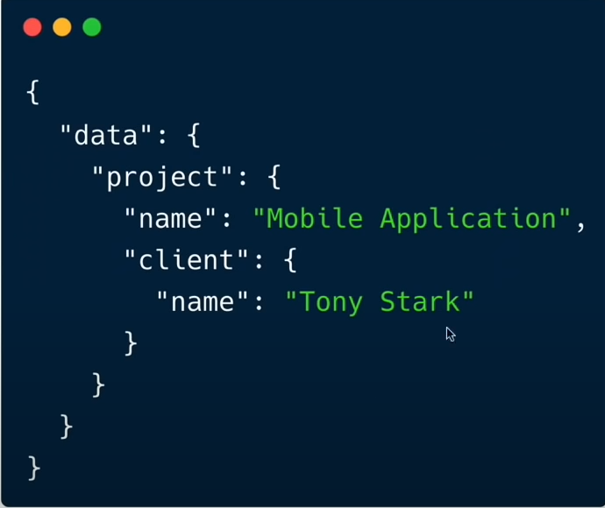

Slide 10
Strengths of GraphQL
Efficiency: No over-fetching or under-fetching.
Flexibility: Clients define the structure of the response.
Reduced Number of Requests: Get all required data in a single request.
Weaknesses of GraphQL
Learning Curve: New concepts for developers familiar with REST.
Security Concerns: Complex queries may lead to security vulnerabilities if not handled properly.
Caching: Traditional caching strategies may not be as effective.

Slide 11
Use Cases
RESTful API Use Cases: Best for simple, stateless operations.
GraphQL Use Cases: Ideal for complex, data-intensive applications.
.

